Slide 1
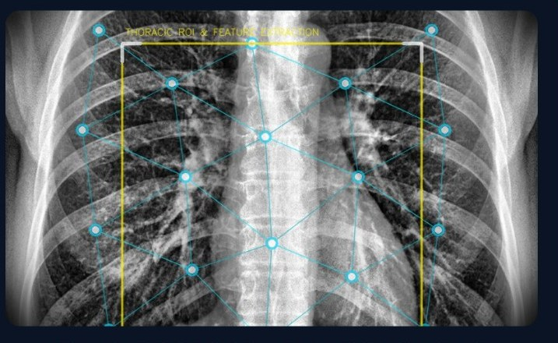
Explainable COVID-19 Detection from Chest X-Ray Images Using Deep Learning and Transfer Learning
MEDICAL AI · CHEST X-RAY RESEARCH
ILLUSTRATIVE · THORACIC ROI
Transfer Learning • Explainable AI • Uncertainty Estimation • Robustness Analysis
Tanvi Patil (PRN 23070521161)
Deveshree Ghaiwat (PRN 24070521510)

Slide 2
Why accuracy alone is not enough
Overlapping signs
Shortcut learning
Over-confidence
Bilateral, peripheral opacities appear in COVID-19 and in other viral or bacterial pneumonias. Early disease can be subtle, so reading the image is hard even for experts.
Independent audits found models that still scored well with the lungs masked out. They had learned borders, markers or source differences, not pathology.
Fine-tuned networks often report probabilities above their real accuracy. A confident wrong answer is more harmful than an admitted doubt.
Goal: study accuracy together with explainability, calibration and robustness in one reproducible protocol.
Explainable COVID-19 Detection from Chest X-Ray Images · 2 / 12

Slide 3
Research problem and objectives
Research problem
Objectives
Chest X-ray classifiers can learn misleading image patterns, produce poorly calibrated confidence scores and offer little transparency.
Develop a three-class chest X-ray classifier
Compare DenseNet121, EfficientNet-B3 and ResNet50
Visualise model attention with Grad-CAM and Integrated Gradients
Evaluate confidence calibration and robustness
Return “uncertain” instead of guessing
Package an interactive research demo
Scope
Three classes: COVID-19, Normal and non-COVID Pneumonia. Pneumonia is kept separate because the real difficulty is telling COVID-19 from other pneumonias.
Explainable COVID-19 Detection from Chest X-Ray Images · 3 / 12

Slide 4
Four questions, one protocol
Accuracy
Explainability
Calibration
Robustness
Does it classify reliably? Measured by macro-F1, per-class recall, ROC-AUC and COVID-19 sensitivity.
Where does it look? Grad-CAM and Integrated Gradients, checked by sanity tests.
Can its confidence be trusted? ECE, Brier score and temperature scaling.
Is it stable under perturbations? Noise, blur, JPEG, lung masking and cross-source tests.
Each question gets its own metrics, so a strong score on one cannot hide a weakness on another.
Explainable COVID-19 Detection from Chest X-Ray Images · 4 / 12

Slide 5
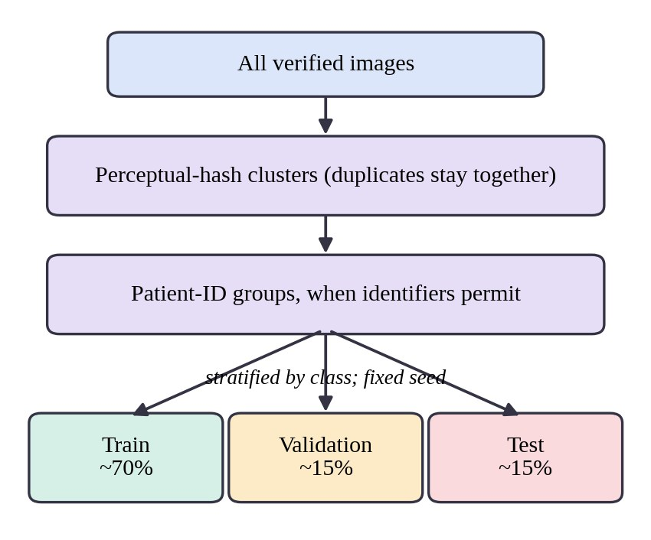
Leakage-aware data protocol
1 Verify annotations and quality
Check labels against source metadata; remove corrupt, blank or non-frontal images.
2 Find duplicates
Exact and perceptual hashes catch copies; each cluster stays in a single split.
3 Split by patient
Patient-level where IDs permit; stratified ~70 / 15 / 15 with a fixed seed. Test set used once.
Duplicate clusters and patient groups are never divided
Explainable COVID-19 Detection from Chest X-Ray Images · 5 / 12

Slide 6
Nine-step methodology
1
Dataset acquisition
2
Annotation verification
3
Quality and duplicate checks
Public chest X-ray sources
Label consistency checks
Hashes, blank and corrupt images
4
Preprocessing and augmentation
5
Patient-level split
6
Transfer learning
300 × 300, mild augmentation
No patient across subsets
Three pretrained backbones
7
Evaluation
8
Explainability and uncertainty
9
Interactive demonstration
Accuracy, calibration, robustness
Heat maps and abstention
Upload, predict, explain
Colour groups: data · preprocessing · model · evaluation · explain and demo
Explainable COVID-19 Detection from Chest X-Ray Images · 6 / 12

Slide 7
Three pretrained backbones
DenseNet121
EfficientNet-B3
ResNet50
Dense connectivity: each layer reuses all earlier feature maps, keeping texture detail available. About 8 M parameters, 1024 features, 224 × 224 native input.
Mobile inverted-bottleneck blocks with squeeze-and-excitation and compound scaling. About 12 M parameters, 1536 features, 300 × 300 native input.
Residual skip connections around bottleneck blocks give stable deep training. About 25.6 M parameters, 2048 features, 224 × 224 native input.
All three start from ImageNet weights, use a 300 × 300 input and share one training and evaluation protocol, so differences come from the architecture.
Explainable COVID-19 Detection from Chest X-Ray Images · 7 / 12

Slide 8
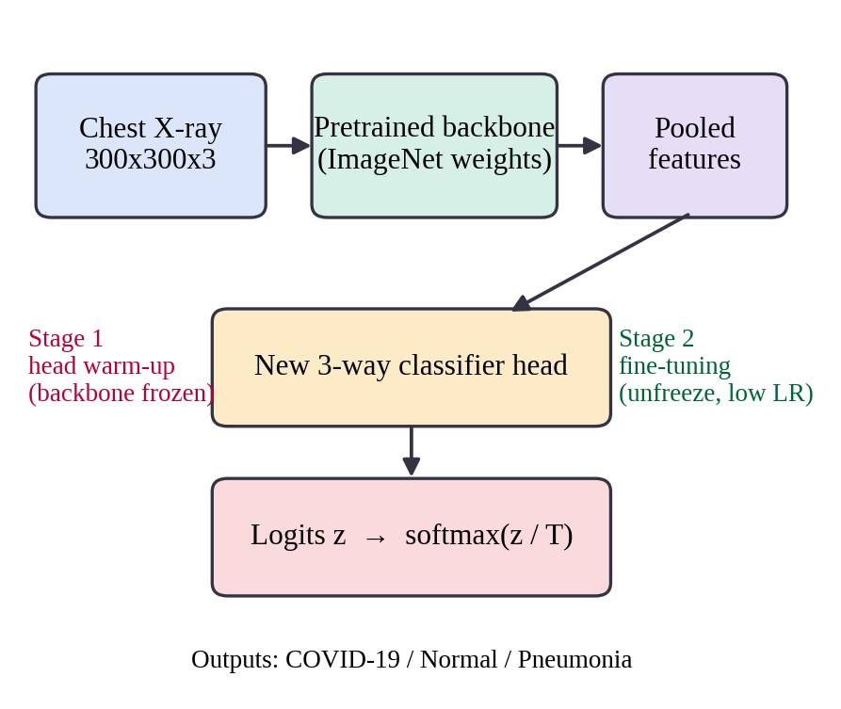
Two-stage transfer learning
Stage 1: head warm-up
Freeze the pretrained backbone and train only the new three-way head, protecting learned features from large early gradients.
Stage 2: fine-tuning
Unfreeze and train at a lower learning rate. Early layers keep generic edges and textures; later layers adapt to radiographs.
Class-weighted loss
wc = N / (K · nc)
AdamW, early stopping on validation macro-F1
Counters imbalance without duplicating images
Explainable COVID-19 Detection from Chest X-Ray Images · 8 / 12

Slide 9
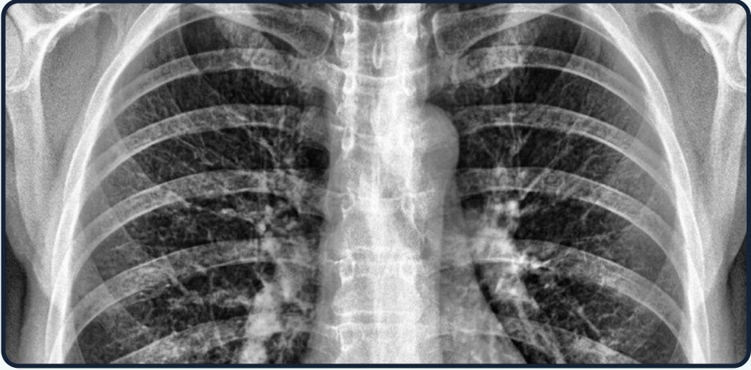
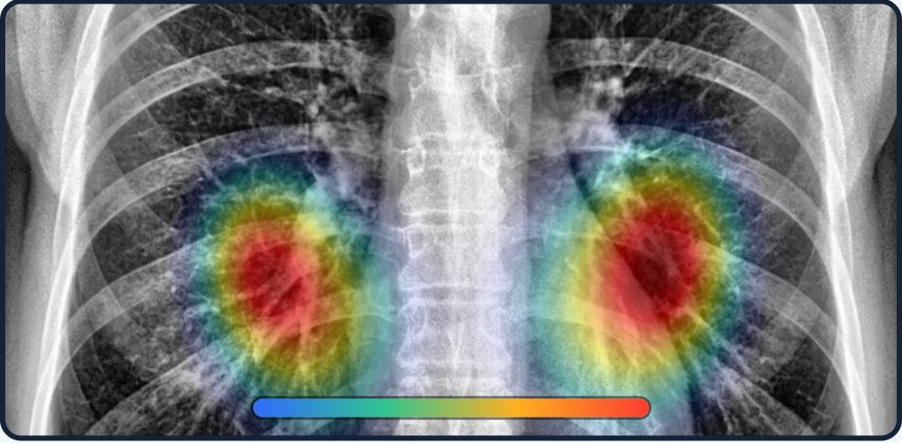
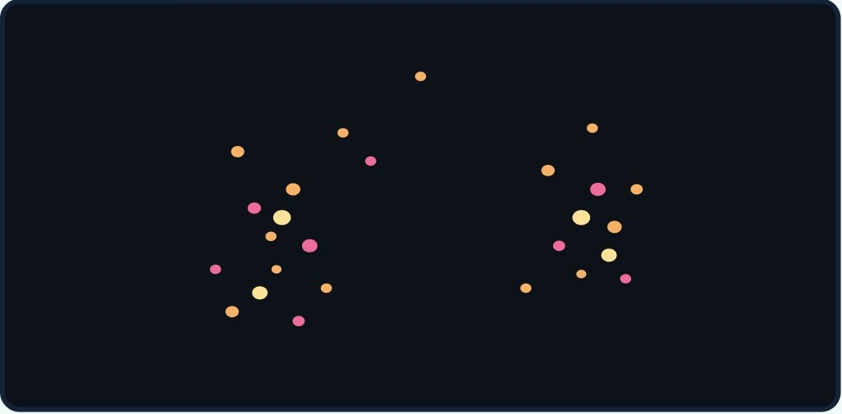
Explainable AI
Original X-ray
Grad-CAM overlay
Integrated Gradients
Grad-CAM gives coarse regions from the last convolutional layer; Integrated Gradients gives pixel-level attribution. Sanity checks: weight randomisation, lung-region overlap, deletion curves and method agreement.
Illustrative visualizations. Highlighted regions do not prove the model’s reasoning.
Explainable COVID-19 Detection from Chest X-Ray Images · 9 / 12

Slide 10
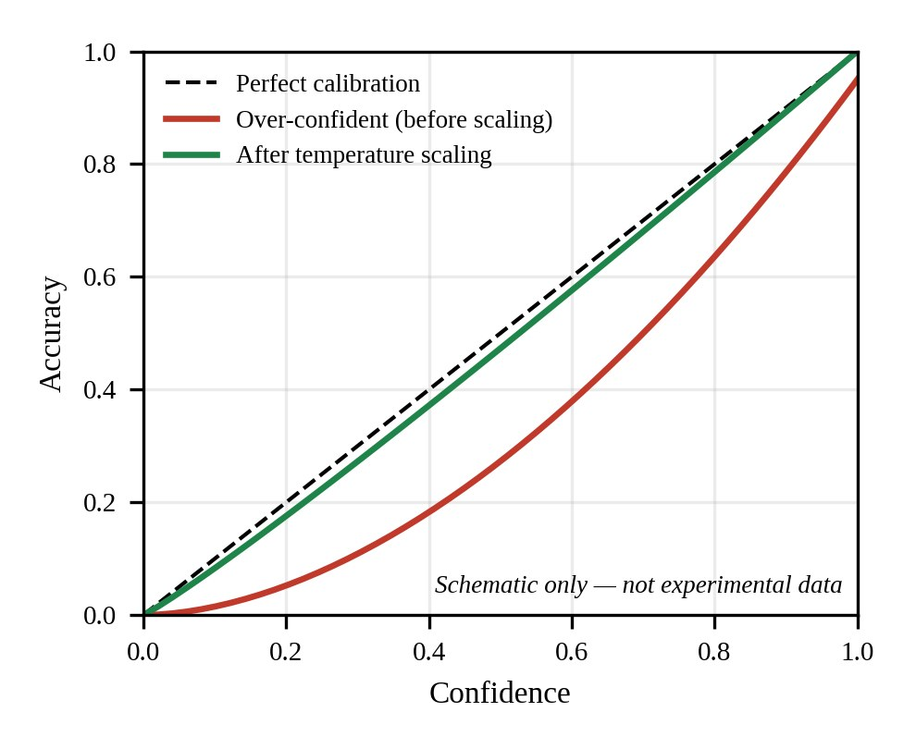
Uncertainty-aware prediction
Image input
Calibrated confidence p (temperature scaling)
p ≥ τ ?
Show prediction + heat map
→
→
→
“Uncertain — Expert Review Required”
Temperature scaling divides logits by one scalar T fitted on validation data. It softens over-confident scores and leaves accuracy unchanged.
Threshold τ is chosen on validation data only, then coverage and selective accuracy are reported. Abstention is a research safeguard, not a guarantee of clinical safety.
Explainable COVID-19 Detection from Chest X-Ray Images · 10 / 12

Slide 11
Evaluation framework
Accuracy
Calibration
Robustness
Deployment
Macro-F1 and per-class recall, confusion matrix, one-vs-rest ROC-AUC, COVID-19 sensitivity and specificity.
ECE and Brier score with reliability diagrams, before and after temperature scaling.
Noise, blur, contrast, JPEG and rotation at five severities, plus lung-masking and cross-source tests.
Inference latency and abstention coverage versus accuracy for the demo.
Plan only · results pending
Bootstrap intervals, repeated seeds and paired tests so that only differences beyond run-to-run variation are called meaningful.
Explainable COVID-19 Detection from Chest X-Ray Images · 11 / 12

Slide 12
Limitations, ethics and outlook
Limitations
Ethics
Next steps
Dataset quality and representativeness may limit generalisation. Leakage and acquisition artefacts must be investigated. External clinical validation is still required.
Only public, de-identified images. COVID-19 sensitivity and specificity are reported separately, and the system abstains rather than guesses.
Run the experiments and fill the results table, test on unseen sources, add conformal abstention and expert review of explanations.
A research prototype, not a diagnostic device.
Explainable COVID-19 Detection from Chest X-Ray Images · 12 / 12

